Slide 1
Classify Handwritten Digits using Tensorflow
Week – 5 Day - 2

Slide 2
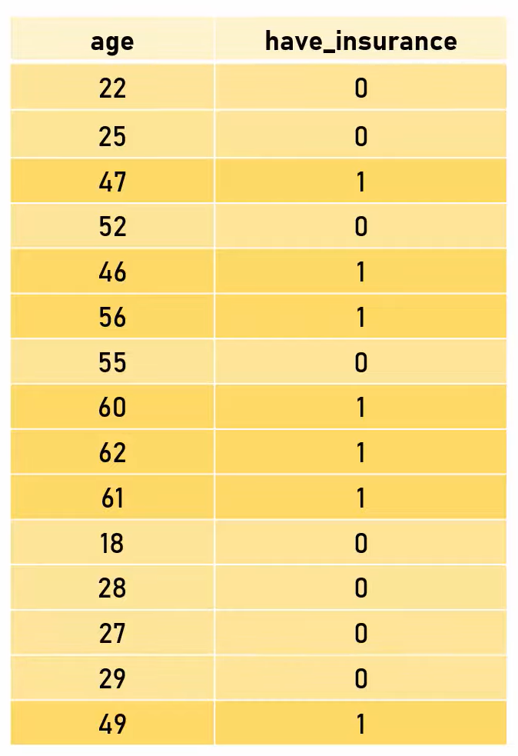
What is a neuron?
Given the age of the person, come up with a function that can predict if the person will buy insurance or not
Binary Classification

Slide 3
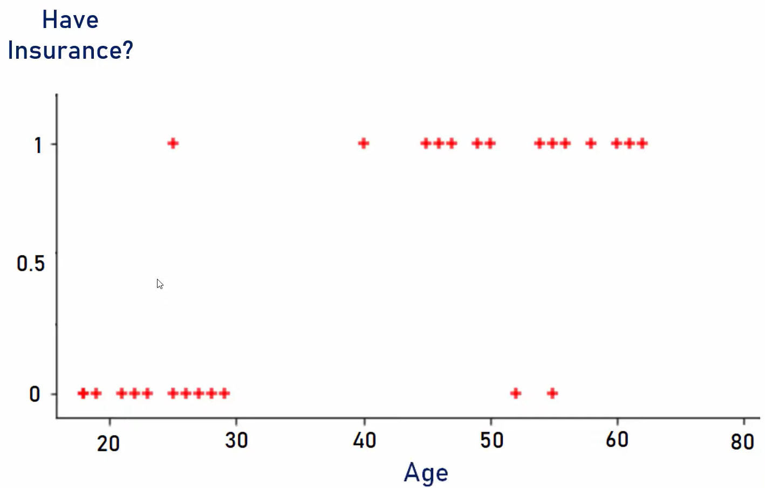
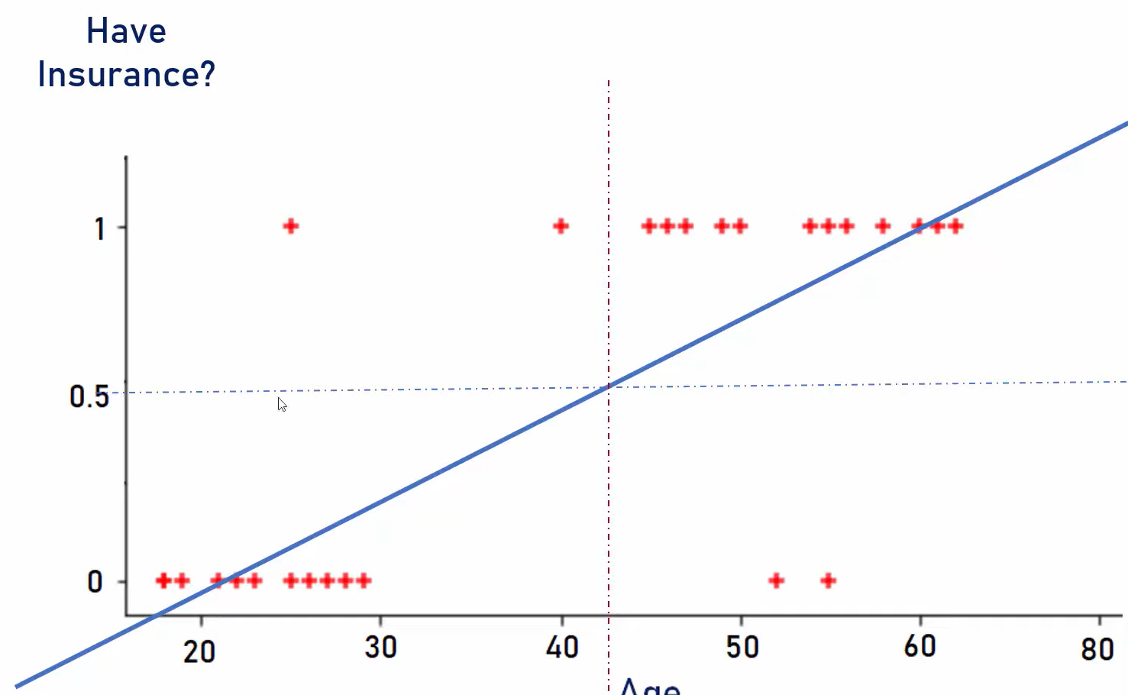
1 – Have insurance 0 – Don’t have insurance
Using linear regression, we can draw a best fit line which will not cover every datapoint
Anything above 0.5 person will buy insurance and below 0.5 will not buy insurance

Slide 4
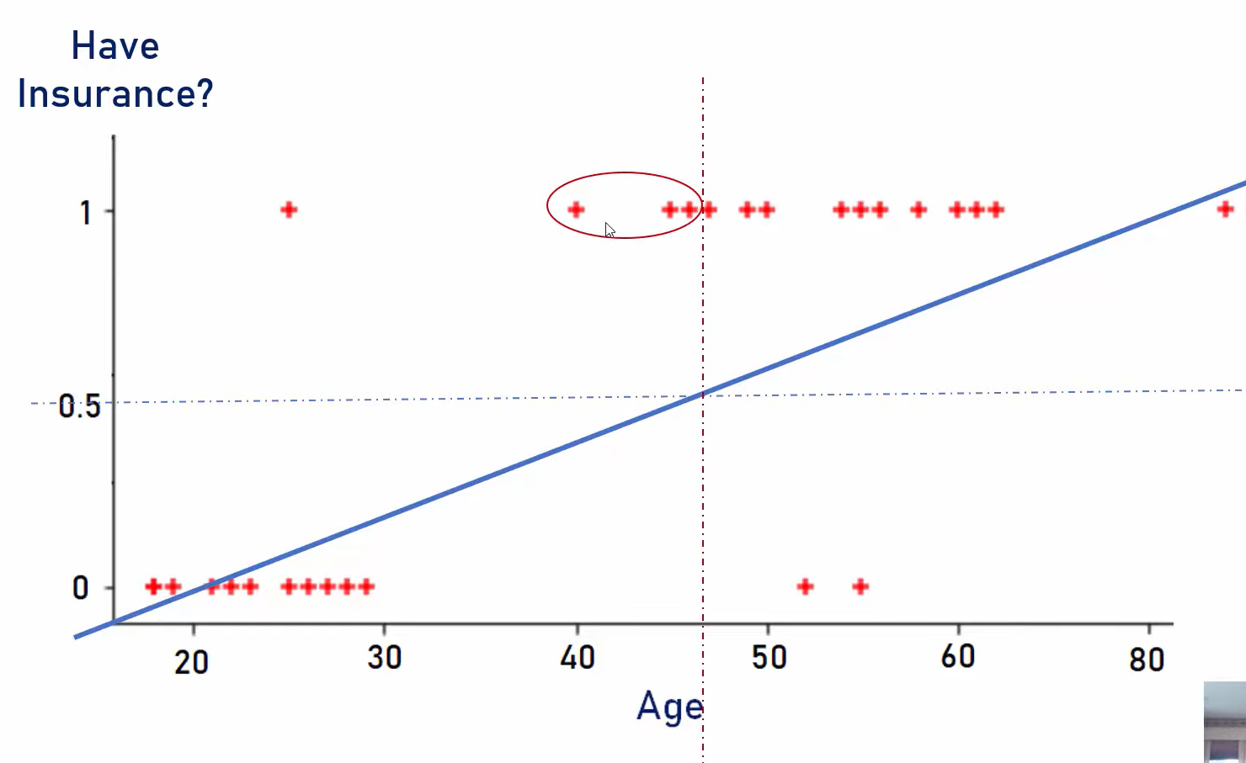
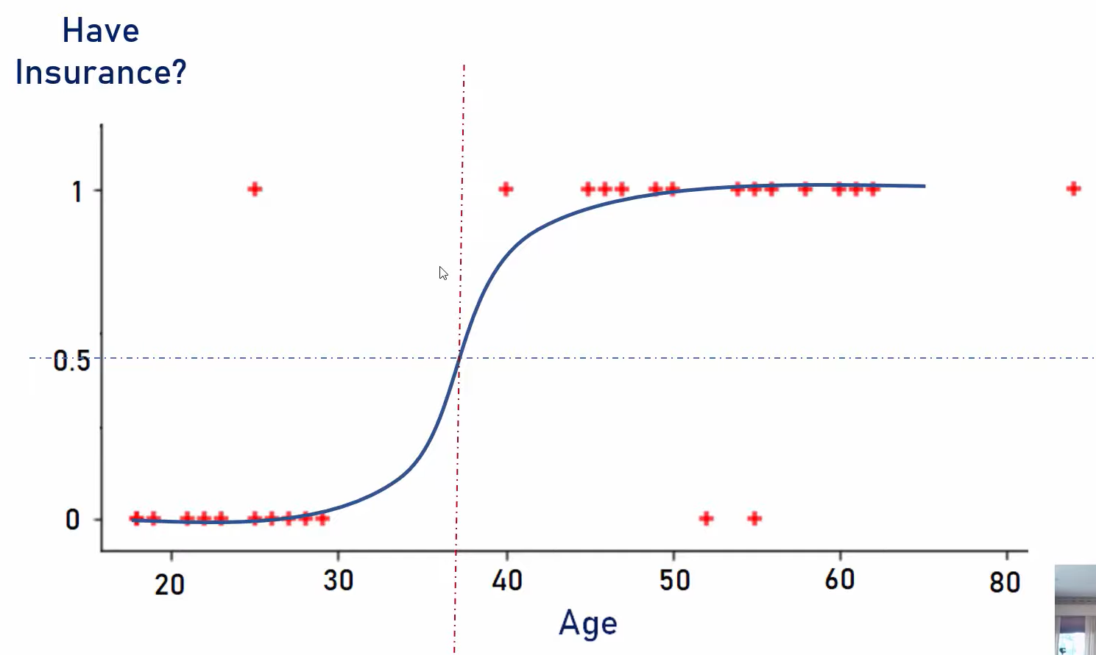
But when we have an outlier, the regression line gets changed and some predictions may go wrong
So, we should use sigmoid or logit function
Sigmoid (z) = 1/1+e^(-z)
e = Euler’s number = 2.71828
Sigmoid function converts input into range of 0 to 1

Slide 5
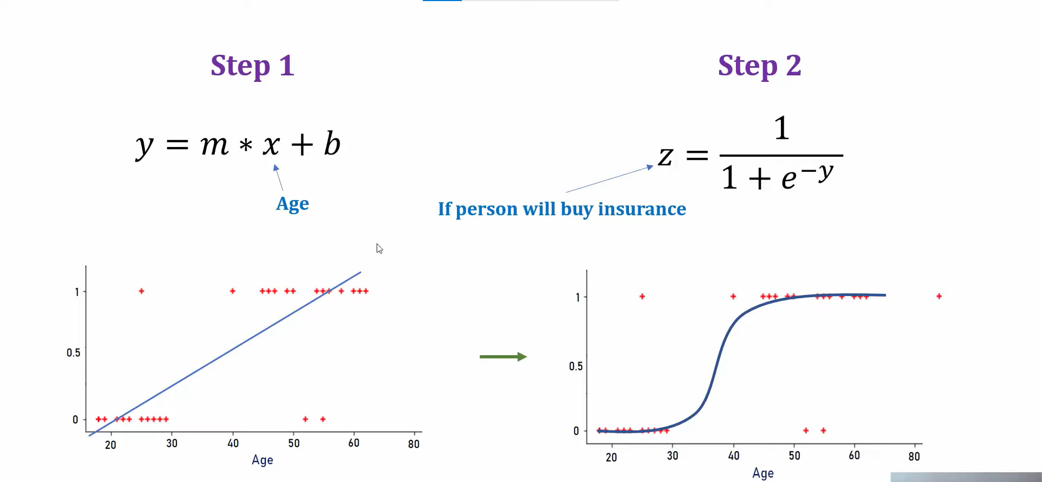
From linear regression we come up with values of m and b

Slide 6
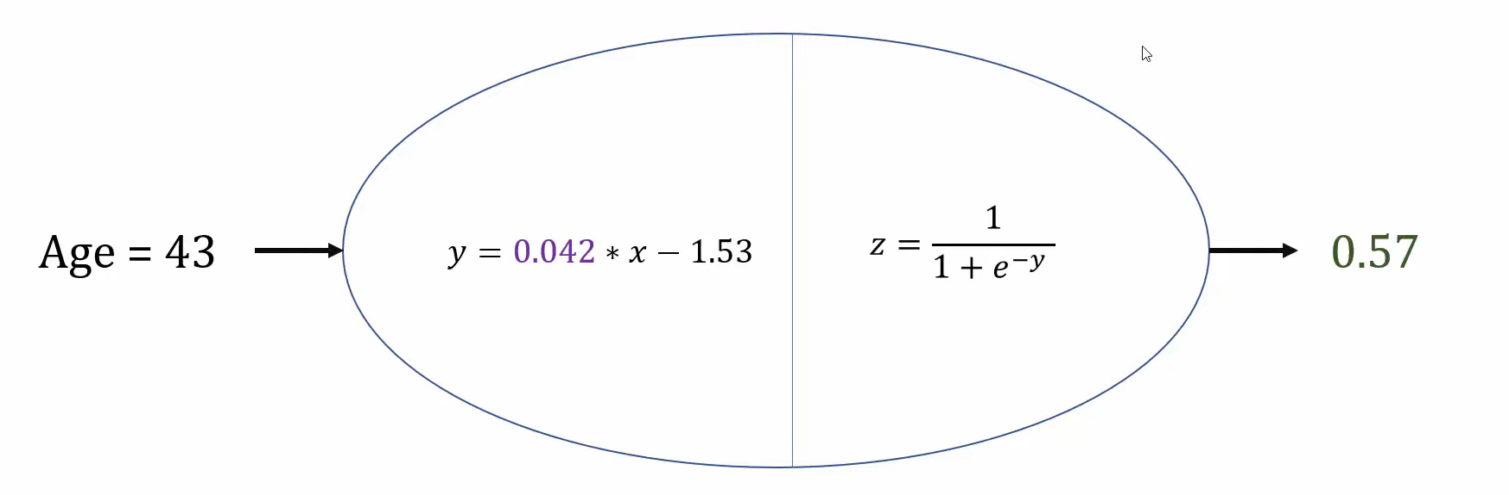
Now we can consider that logistic regression contains a single neuron First part is linear equation, and second part is activation function

Slide 7
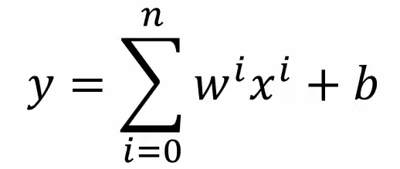
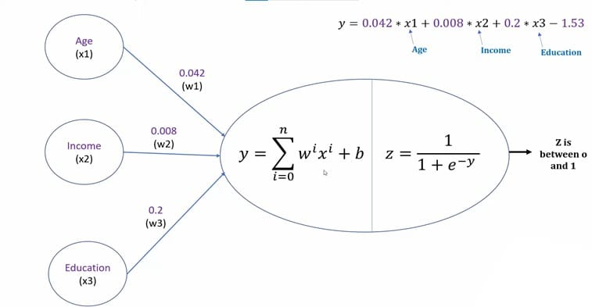
Here age is the only independent variable
But in general, we have more independent variables like age, income, education
So, the linear equation will be
y = w1 * x1 + w2 * x2 + w3 * x3 + b

Slide 8
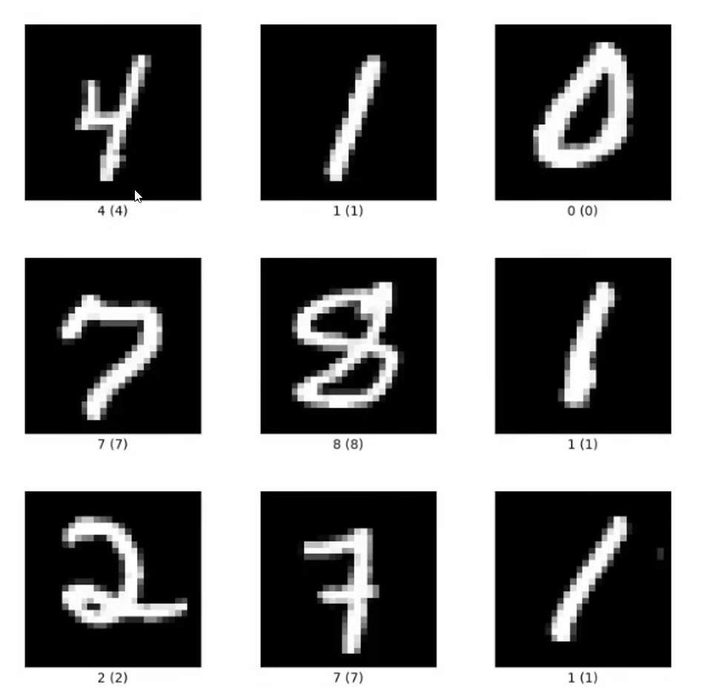
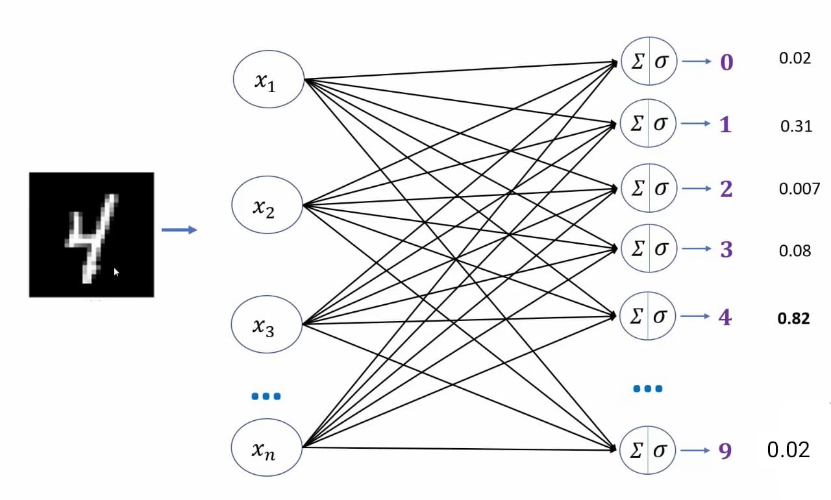
Handwritten digits
But how do we feed image into neuron?

Slide 9
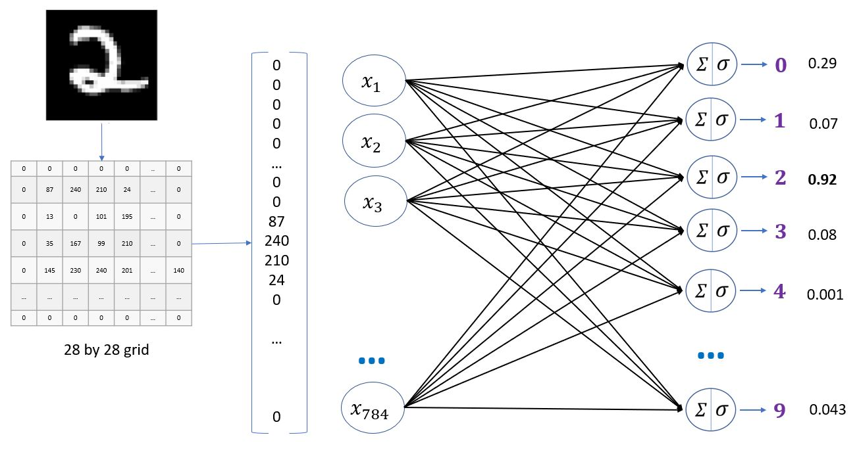
Image is a 2d matrix where each pixel is represented by 0 – 255 0 – Black 255 – White 28 x 28 grid is one dimensional array of size 784 therefore, our neural network will have 784 input neurons

